Slide 1

C++ and Java
Katheryn Knutson
Programming Languages

Slide 2

Why I chose these languages
I have been working in Java for almost 4 years….
Worked on computers with my dad since I was a kid
Followed up with computer classes in high school

Slide 3
Java
Developed by Sun Microsystems in the 1990s
Java is also a “simple, efficient, general-purpose language”
Java is usable across platforms, object oriented and interpreted
The same Java application will run identically on any computer, regardless of hardware features or operating system, as long as it has a Java interpreter
Java also has a feature called Java Applets

Slide 4
C++
Developed by Bjarne Stroustrup in 1979 at Bells Lab
C++ is a compiled language that is for general purpose coding, it is statically typed and free form
C++ is generally known as a middle-level difficulty language, and is also object-oriented
Any C program will also work in C++, because C++ is a superset of C.
C++ supports encapsulation, data hiding, inheritance and polymorphism

Slide 5
Similarities
C++ and Java have similar syntax.
Both languages have identical comment methods
C++ and Java support inheritance and pointers, although used in different ways
The primitive types in C++ and Java are nearly identical
Both languages have a ‘main’ within the code in which the entry point is executed
Both languages support polymorphism, abstraction, and encapsulation
Both languages are used in Android, Mac, and Windows applications. They are used co-dependently with other languages and environments and are often used in the field to develop highly complex systems.

Slide 6
Differences
Java code runs a little slower (because of the JVM) but it is more portable and has much better security features
While C++ permits the user to overload the computer, Java does not
Java is also a dynamic language, meaning that the user can modify the code while it is running as C++ does not support this
C++ contains predefined data types which may change from platform to platform while Java is the same on any platform
Global data and methods cannot reside outside of a class in Java, whereas C++ allows this
C++ is mainly used for system programming while Java is mainly used for application programming

Slide 7
The hypothesis (or prediction)
The languages will be similar in low level programming projects

Slide 8
Problem
The problem originates from a developer position. When given a goal, a project or an assignment from work or school, a student or developer most usually has the task of choosing the language or languages that would be best suited in achieving the goal. In some situations, companies and professors may have required language that the developer is forced to use. But in many situations in the field, the developer is going to have to make an educated decision about the language that will be used to complete a task. Some developers may choose the language that they have the most experience with and are most comfortable with; this method is immature. To best further computer science and most efficiently complete a goal, the language used needs to be the best one for the task.

Slide 9
My testing method
These experiments are meant to test the necessities of a programming language. These experiments are common in introductory programming courses. If the tools and methods used in the experiments are easy to understand and use, they will most definitely be scalable for higher level projects.
Ease of development
Speed of development
Language Performance
Language Readability
Compatibility
The experiment consists of phenomena common in a coding or programming sphere. It will contain basic processing of mathematical concepts. It will include things such as if-statements and loops. The programs will take in user input and contain print statements.

Slide 10
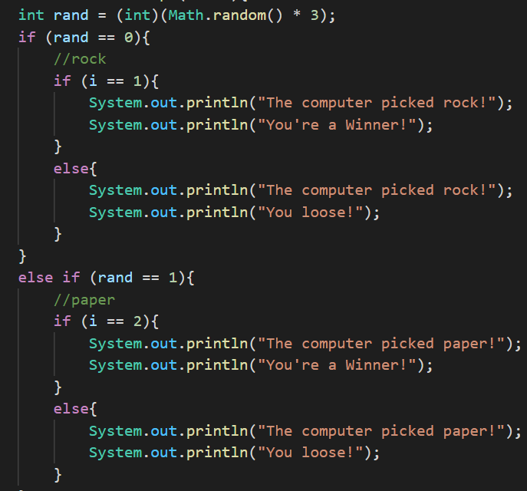
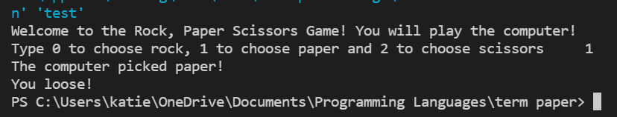
Rock, Paper, Scissors
Tests user input, comparisons, and print statements

Slide 11
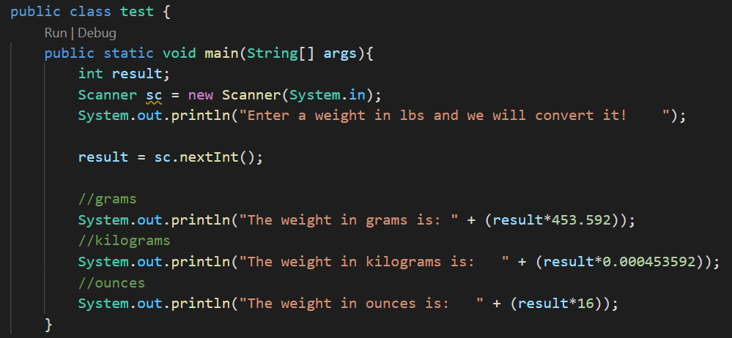
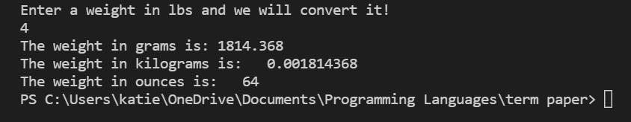
Weight Converter
Tests user input, mathematical operations and print statements

Slide 12
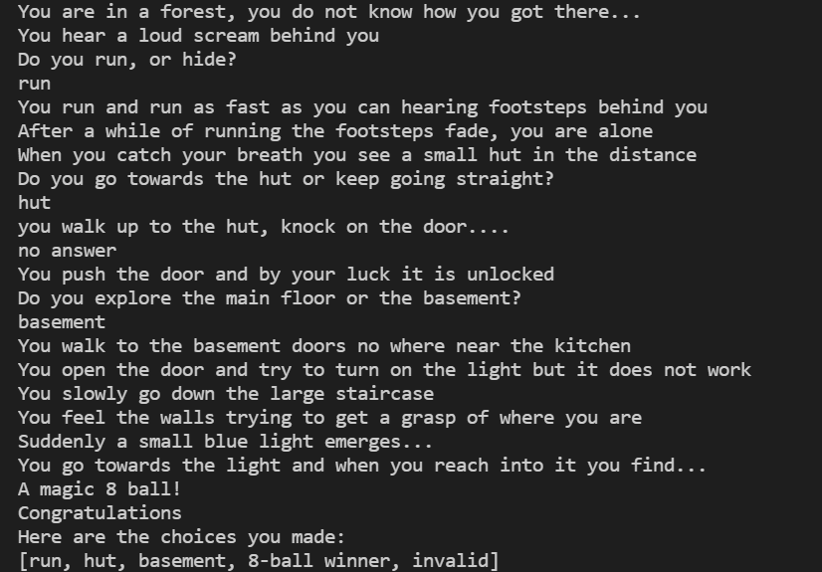
Text Adventure Game
Tests user input, comparisons, stacks, mathematical operations and print statements

Slide 13



Aha! Results
C++ and Java are similar in low level programming experiments
C++ and Java performed equally well with, print statements, if statements, loops, and mathematical operations
C++ performed better with user input
Java performed better with stacks

Slide 14
I was right!

Slide 15
Conclusion
I have concluded that it would take the same amount of time to solve a problem in each language. Each of the codes are equally readable. They both handle operations and low to high level concepts similarly.
Throughout my research I learned that the applications for each language in the real world are entirely different. While each language would perform similarly in a small-scale academic pretense, they would perform differently in a high-level environment in which larger problems needed to be solved.
I propose that high level projects be conducted to reach a more accurate conclusion.

